Slide 1
CS0303 Computer Networks
Unit – I– Introduction to Computer Networks

Slide 2
Networking
Computer network A collection of computing devices that are connected in various ways in order to communicate and share resources
Usually, the connections between computers in a network are made using physical wires or cables
  However, some connections are wireless, using radio waves or infrared signals

Slide 3
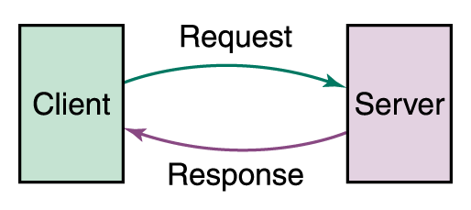
Networking
Computer networks have opened up an entire frontier in the world of computing called the client/server model
Figure 15.1 Client/Server interaction

Slide 4
Types of Networks
Local-area network (LAN) A network that connects a relatively small number of machines in a relatively close geographical area

Slide 5
Types of Networks
Various configurations, called topologies, have been used to administer LANs
  Ring topology A configuration that connects all nodes in a closed loop on which messages travel in one direction
  Star topology A configuration that centers around one node to which all others are connected and through which all messages are sent
  Bus topology All nodes are connected to a single communication line that carries messages in both directions

Slide 6
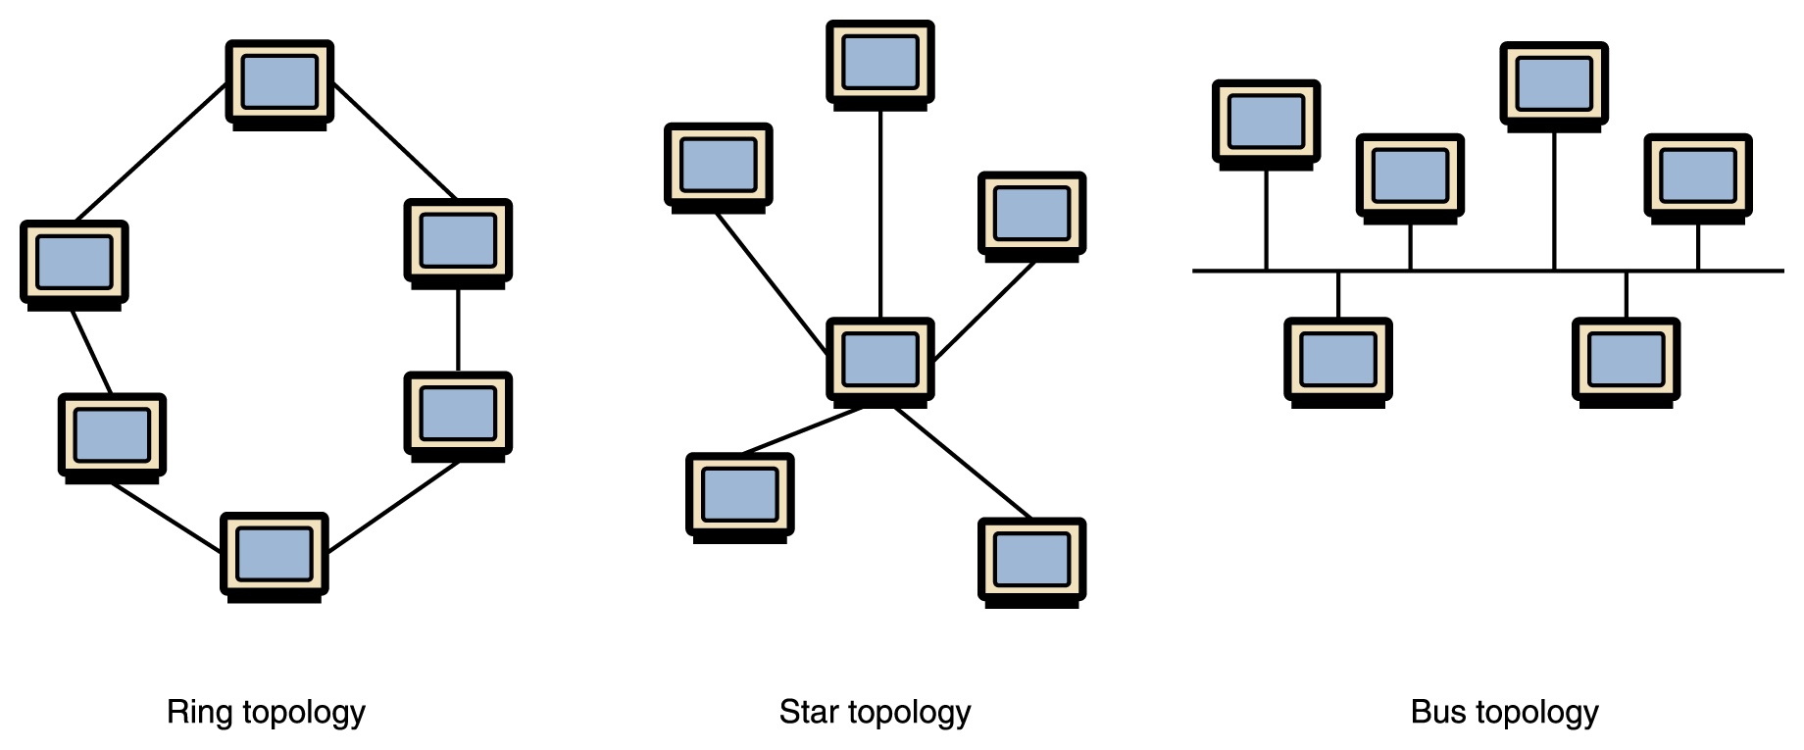
Types of Networks
Figure 15.2 Various network topologies
A bus technology called Ethernet has become the industry standard for local-area networks

Slide 7
Types of Networks
Wide-area network (WAN) A network that connects two or more local-area networks over a potentially large geographic distance
  Often one particular node on a LAN is set up to serve as a gateway to handle all communication going between that LAN and other networks
Communication between networks is called internetworking
  The Internet, as we know it today, is essentially the ultimate wide-area network, spanning the entire globe

Slide 8
Types of Networks
Metropolitan-area network (MAN) The communication infrastructures that have been developed in and around large cities

Slide 9
So, who owns the Internet?
Well, nobody does. No single person or company owns the Internet or even controls it entirely. As a wide-area network, it is made up of many smaller networks. These smaller networks are often owned and managed by a person or organization. The Internet, then, is really defined by how connections can be made between these networks.

Slide 10
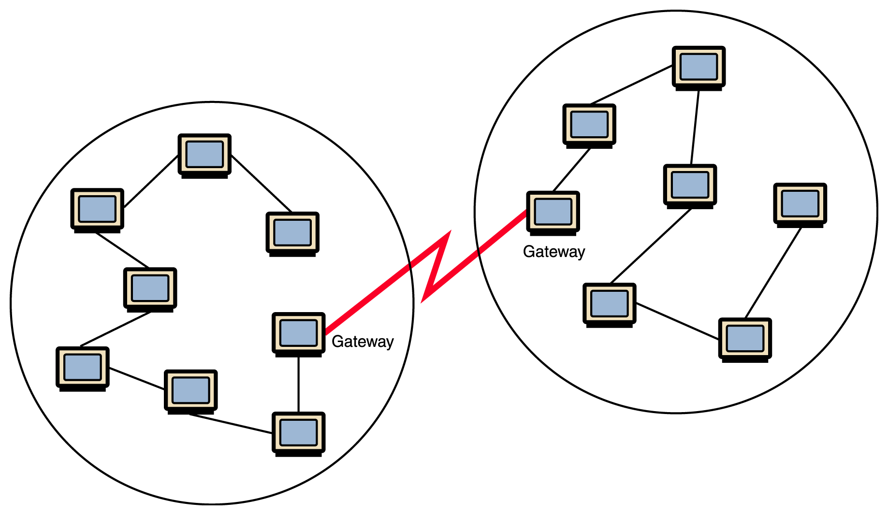
Types of Networks
Figure 15.1 Local-area networks connected across a distance to create a wide-area network

Slide 11
Internet Connections
Internet backbone A set of high-speed networks that carry Internet traffic
These networks are provided by companies such as AT&T, GTE, and IBM
Internet service provider (ISP) A company that provides other companies or individuals with access to the Internet

Slide 12
Internet Connections
There are various technologies available that you can use to connect a home computer to the Internet
  A phone modem converts computer data into an analog audio signal for transfer over a telephone line, and then a modem at the destination converts it back again into data
  A digital subscriber line (DSL) uses regular copper phone lines to transfer digital data to and from the phone company’s central office
  A cable modem uses the same line that your cable TV signals come in on to transfer the data back and forth

Slide 13
Internet Connections
Broadband A connection in which transfer speeds are faster than 128 bits per second
  DSL connections and cable modems are broadband connections
  The speed for downloads (getting data from the Internet to your home computer) may not be the same as uploads (sending data from your home computer to the Internet)

Slide 14
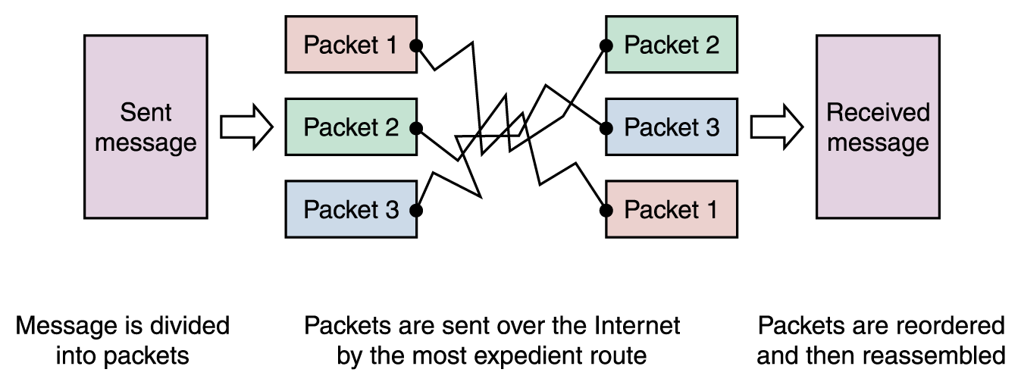
Packet Switching
To improve the efficiency of transferring information over a shared communication line, messages are divided into fixed-sized, numbered packets
Network devices called routers are used to direct packets between networks
Figure 15.4
Messages sent by packet switching

Slide 15
Open Systems
Proprietary system A system that uses technologies kept private by a particular commercial vendor
  One system couldn’t communicate with another, leading to the need for
Interoperability The ability of software and hardware on multiple machines and from multiple commercial vendors to communicate
  Leading to
Open systems Systems based on a common model of network architecture and a suite of protocols used in its implementation

Slide 16
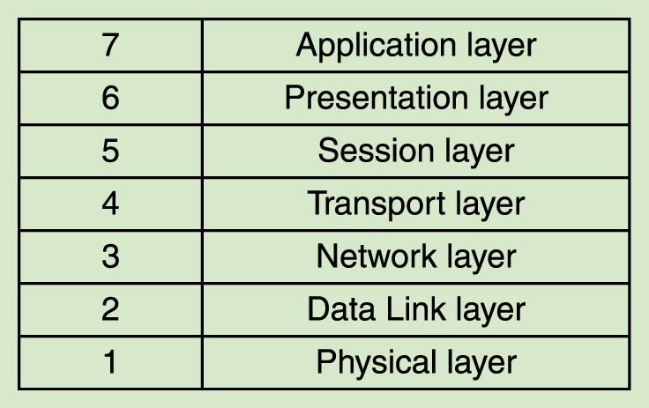
Open Systems
The International Organization for Standardization (ISO) established the Open Systems Interconnection (OSI) Reference Model
Each layer deals with a particular aspect of network communication
Figure 15.5 The layers of the OSI Reference Model

Slide 17
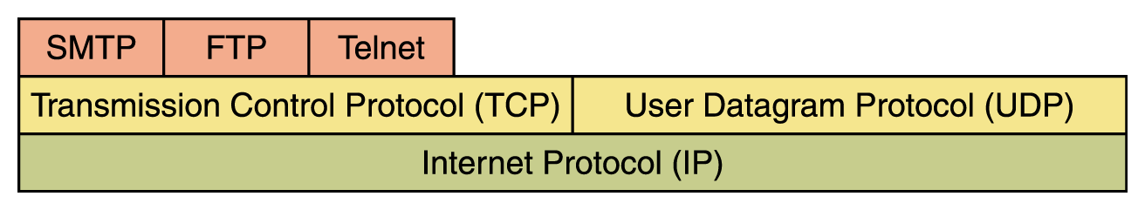
Network Protocols
Network protocols are layered such that each one relies on the protocols that underlie it
Sometimes referred to as a protocol stack
Figure 15.6 Layering of key network protocols

Slide 18
TCP/IP
TCP stands for Transmission Control Protocol
  TCP software breaks messages into packets, hands them off to the IP software for delivery, and then orders and reassembles the packets at their destination
IP stands for Internet Protocol
  IP software deals with the routing of packets through the maze of interconnected networks to their final destination

Slide 19
TCP/IP (cont.)
UDP stands for User Datagram Protocol
  It is an alternative to TCP
  The main difference is that TCP is highly reliable, at the cost of decreased performance, while UDP is less reliable, but generally faster

Slide 20
High-Level Protocols
Other protocols build on the foundation established by the TCP/IP protocol suite
  Simple Mail Transfer Protocol (SMTP)
  File Transfer Protocol (FTP)
  Telnet
  Hyper Text Transfer Protocol (http)

Slide 21
OSI Model Background
Introduced in 1978 and revised in 1984
Formulates the communication process into structured layers
There are seven layers in the model, hence the name the 7-Layer model
The model acts as a frame of reference in the design of communications and networking products

Slide 22
The Layered Approach to Communication
7. Application
6. Presentation
5. Session
4. Transport
3. Network
2. Data Link
1. Physical

Slide 23
Division of Layers
7. Application
6. Presentation
Upper Layers
5. Session
4. Transport
Middle Layer
3. Network
2. Data Link
Lower Layers
1. Physical

Slide 24
The Function of a Layer
Each layer deals with one aspect of networking
  Layer 1 deals with the communication media
Each layer communicates with the adjacent layers
  In both directions
  Ex: Network layer communicates with:
    Transport layer
    Data Link layer
Each layer formats the data packet
  Ex: Adds or deletes addresses

Slide 25
Role of Layers
Node A
7. Application
6. Presentation
Data In
1. Physical
To/from
Node B
Data Out

Slide 26
Communication Between Layers
7. Application
Data
Encapsulation
6. Presentation
Data
Stripping
5. Session

Slide 27
The Role of Layers in Point-to-point Communication
Node a
Node b
7. Application
7. Application
1.Physical
1. Physical

Slide 28
Virtual Communication Between Layers
7. Application
7. Application
3. Network
3. Network

Slide 29
Application Layer
Purpose
  User application to network service interface
Examples
  File request from server
  E-mail services
  etc.

Slide 30
Application Layer Function
General network access
Flow control
Error recovery

Slide 31
Presentation Layer
Purpose
  Formats data for exchange between points of communication
    Ex: Between nodes in a network
Example:
  Redirector software
    Formats for transmission to the server

Slide 32
Presentation Layer Function
Protocol conversion
Data translation
Encryption
Character set conversion
Expansion of graphics command

Slide 33
Session Layer
Purpose
  Oversee a communication session
    Establish
    Maintain
    Terminate

Slide 34
Session Layer Function
Performs name recognition and related security
Synchronization between sender and receiver
Assignment of time for transmission
  Start time
  End time etc.

Slide 35
Transport Layer
Purpose
  Repackage proper and efficient delivery of packages
    Error free
    In sequence
    Without duplication

Slide 36
Transport Layer Function
For sending data
  Repackage the message to fit into packets
    Split long messages
    Assemble small messages
On receiving data
  Perform the reverse
  Send an acknowledgment to the sender
Solve packet problems
  During transmission and reception

Slide 37
Network Layer
Purpose
  Addressing and routing the packets
Example application at the router
  If the packet size is large, splits into small packets

Slide 38
Network Layer Function
Address messages
Address translation from logical to physical
  Ex: nganesa ----------> 102.13.345.25
Routing of data
  Based on priority
  Best path at the time of transmission
Congestion control

Slide 39
Data Link Layer
Purpose
  Manages the flow of data over the physical media
Responsible for error-free transmission over the physical media
Assures error-free data submission to the Network Layer

Slide 40
Data Link Layer Function
Point of origin
  Packages data for transmission over physical line
Receiving end
  Packages data for submission to the network layer
Deals with network transmission protocols
  IEEE 802. protocols

Slide 41
Data Link Layer Subdivision
Improvement to ISO Model
Logical Link Control (LLC) sub-layer
  Manages service access points (logical link)
  Error and flow control
Media Access Control (MAC) sub-layer
  Applies directly to network card communication
  Access control

Slide 42
Media Access Control Application
Network Interface Card driver
NETWORK
SOFTWARE
NETWORK
CARD
NIC Driver
facilitates data
transfer

Slide 43
Physical Layer
Purpose
  Deals with the transmission of 0s and 1s over the physical media
    Translation of bits into signals
Example
  Pulse duration determination
  Transmission synchronization
  etc.

Slide 44
Physical Layer Function
Encode bits into signals
  Carry data from the h higher layers
Define the interface to the card
  Electrical
  Mechanical
  Functional
  Example: Pin count on the connector

Slide 45
TCP/IP
A highly standardized protocol used widely on the Internet
Standards area available in the form of RFC documents
  Request For Comments (RFC)
Standards are overseen by the Internet Engineering Task Force (IETF)

Slide 46
Comparison of ISO-OSI Model and the DOD (TCP/IP) Model
Source: http://starter.sdsu.edu/remote/demo/osi-tcp.html
Application
Application
Presentation
Session
Transport
Host-to-Host
Network
Internet
Data Link
Network Access
Physical

Slide 47
Layer Reference to Protocol Recalled
Application
Application
FTP, Telnet, SMTP, HTTP..
Presentation
Session
Transport
Host-to-Host
TCP, UDP
Network
Internet
IP, ICMP, IGMP
Data Link
Network Access
Ethernet, Token-Ring ...
Physical
Source: http://starter.sdsu.edu/remote/demo/osi-tcp.html

Slide 48
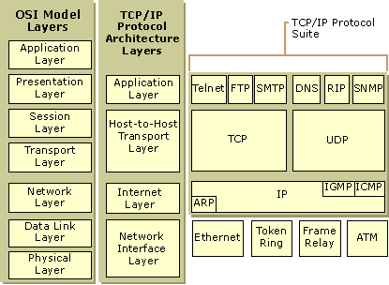
Source: TCP/IP White Paper by Microsoft

Slide 49
TCP/IP Layers
Network interface layer
Internet layer
Host-to-host transport layer
Application layer

Slide 50
Network Interface Layer
Responsible for sending and receiving TCP/IP packets on the network medium (physical/Data Link)
Applicable LAN technologies
  Ethernet, Token Ring, FDDI etc.
Applicable WAN technologies
  X.25 (old), Frame Relay, ATM etc.
Note that some technologies such as ATM and FDDI may be used at both the WAN and the LAN levels

Slide 51


Relationship to OSI Model
Data Link Layer
Network Interface
Layer
Physical Layer
ISO Model
TCP/IP Model

Slide 52
Internet Layer
Packaging
Addressing
Routing

Slide 53
Transport Layer
Sequencing and transmission of packets
Acknowledgment of receipts
Recovery of packets
Flow control
In essence, it engages in host-to-host transportation of data packets and the delivery of them to the application layer

Slide 54
TCP
Transmission Control Protocol (TCP)
One-to-one and connection-oriented reliable protocol
Used in the accurate transmission of large amount of data
Slower compared to UDP because of additional error checking being performed

Slide 55
UDP
User Datagram Protocol (UDP)
One-to-one or one-to-many,connectionless and unreliable protocol
Used for the transmission of small amount of data
  Accuracy is not of prime concern
  The overhead of establishing a TCP connection is not warranted
Used in video and audio casting
  Multicasting
  Broadcasting
Also used for multimedia transmission
Faster compared to TCP

Slide 56
Network Topologies

Slide 57
Simple Physical Topologies
Physical topology: physical layout of nodes on a network
Three fundamental shapes:
  Bus
  Ring
  Star
May create hybrid topologies
Topology integral to type of network, cabling infrastructure, and transmission media used

Slide 58
Bus
Single cable connects all network nodes without intervening connectivity devices
Devices share responsibility for getting data from one point to another
Terminators stop signals after reaching end of wire
  Prevent signal bounce
Inexpensive, not very scalable
Difficult to troubleshoot, not fault-tolerant

Slide 59
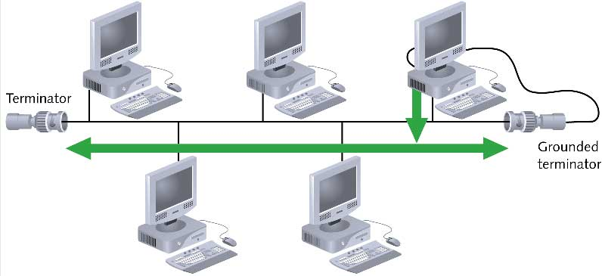
Bus (continued)

Slide 60
Advantages of Bus Topology
Works well for small networks
Relatively inexpensive to implement
Easy to add to it

Slide 61
Disadvantages of
Bus Topology
Management costs can be high
Potential for congestion with network traffic

Slide 62
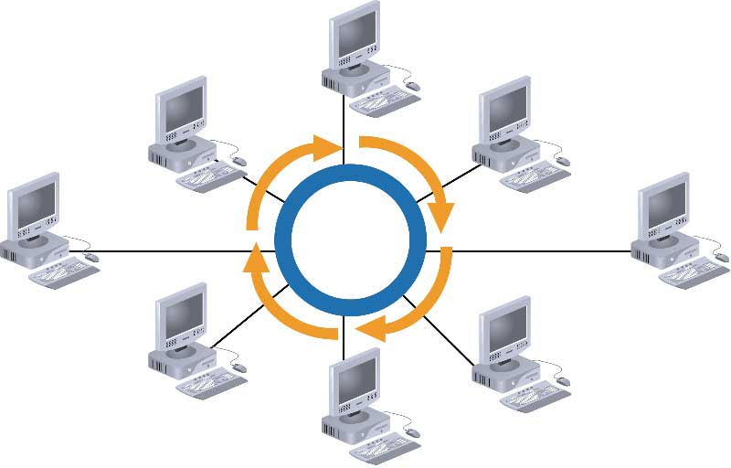
Ring

Slide 63
Advantages of Ring Topology
Easier to manage; easier to locate a defective node or cable problem
Well-suited for transmitting signals over long distances on a LAN
Handles high-volume network traffic
Enables reliable communication

Slide 64
Disadvantages of
Ring Topology
Expensive
Requires more cable and network equipment at the start
Not used as widely as bus topology
  Fewer equipment options
  Fewer options for expansion to high-speed communication

Slide 65
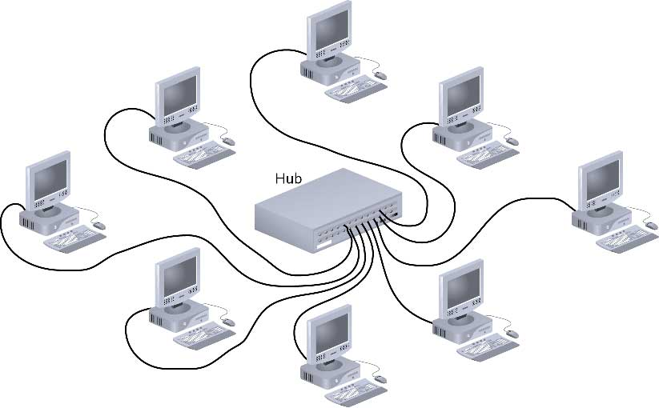
Star

Slide 66
Star (continued)
Any single cable connects only two devices
  Cabling problems affect two nodes at most
Requires more cabling than ring or bus networks
  More fault-tolerant
Easily moved, isolated, or interconnected with other networks
  Scalable
Supports max of 1024 addressable nodes on logical network

Slide 67
Advantages of Star Topology
Good option for modern networks
Low startup costs
Easy to manage
Offers opportunities for expansion
Most popular topology in use; wide variety of equipment available

Slide 68
Disadvantages of
Star Topology
Hub is a single point of failure
Requires more cable than the bus

Slide 69
Logical Topologies
Logical topology: how data is transmitted between nodes
  May not match physical topology
Bus logical topology: signals travel from one network device to all other devices on network
  Required by bus, star, star-wired physical topologies
Ring logical topology: signals follow circular path between sender and receiver
  Required by ring, star-wired ring topologies

Slide 70
Definition
Wireless Sensor Networks (WSNs):
  Highly distributed networks of small, lightweight wireless nodes,
  Deployed in large numbers,
  Monitors the environment or system by measuring physical parameters such as temperature, pressure, humidity.
Node:
  sensing + processing + communication

Slide 71
Applications of WSNs
Constant monitoring & detection of specific events
Military, battlefield surveillance
Forest fire & flood detection
Habitat exploration of animals
Patient monitoring
Home appliances

Slide 72
Comparison with Ad Hoc Wireless Networks
Both consist of wireless nodes but they are different.
  The number of nodes is very large
  Being more prone to failure, energy drain
  Not having unique global IDs
  Data-centric, query-based addressing vs. address-centric
  Resource limitations: memory, power, processing

Slide 73
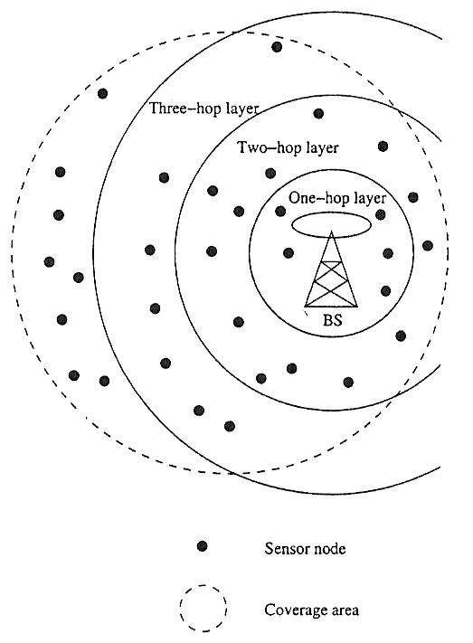
Layered Architecture
A single powerful base station (BS)
Layers of sensor nodes around BS
Layer i: All nodes i-hop away from BS
Applications:
  In-building: BS is an access point
  Military
Short-distance, low power tx

Slide 74
Optical Fiber
Attenuation: Due to Rayleigh scattering and chemical absorptions,
the light intensity along a fiber decreases with
distance. This optical loss is a function of wavelength
(see plot).
Dispersion: Different colors travel at different speeds down the
optical fiber. This causes the light pulses to spread
in time and limits data rates.
launch
receive
Types of Dispersion
⬆
Chromatic Dispersion is caused mainly by the
wavelength dependence of the index of
refraction (dominant in SM fibers)
t
t
Modal Dispersion arises from the differences in
group velocity between the “modes” travelling
down the fiber (dominant in MM fibers)
⬆
t
t

